Slide 1



OPPORTUNITY REVIEW
WHA DIRECT TO EMPLOYER PLAN
Exploring a Western Health Alliance State-Wide Health Plan

Slide 2


Founded in 1979, headquartered in Indianapolis
Largest Independently-Owned Full-Service Third-Party Administrator
Specialize in Administration of Self-Funded Plans and Population Health Management​
Leader in the Direct-to-Employer Movement
We Know and Understand the Market
Experience Working with All Professional Teams: Agents, Networks, MGAs
The Key Family of Companies is a Vertically Integrated group of benefit related organizations
3,000+ Corporate Clients
3 Million Members under Management
700 Employees

Slide 3


MARKET LEADER
IN
PRIVATE LABELED
HEALTH PLANS
Louisville, KY
OneHealth Plan
Cincinnati, OH
TCH Optimal
Bentonville, AR
Northwest Health Plan
Knoxville, TN
East Tennessee Health Plan
Meridian, MS
Affinity Health Plan
Fort Myers, FL
Lee Health Care Partners

Slide 4


DIRECT-TO-EMPLOYER (DTE)
YOU Pick the Name of the Health Plan
YOU Determine the Fees Charged
YOU Practice the Medicine
YOU Receive the Profits
WE Make it Successful
Your Health Plan Focused on a Direct Relationship with Self-Funded Employers in Your Market

Slide 5
DIRECT-TO-EMPLOYER STRATEGY: ONLY AVAILABLE TO PREMIER HEALTH SYSTEMS
STRONG Brand Quality
EXTENSIVE Patient Access
AFFORDABLE Value Pricing
EXCELLENT Care Quality

Slide 6
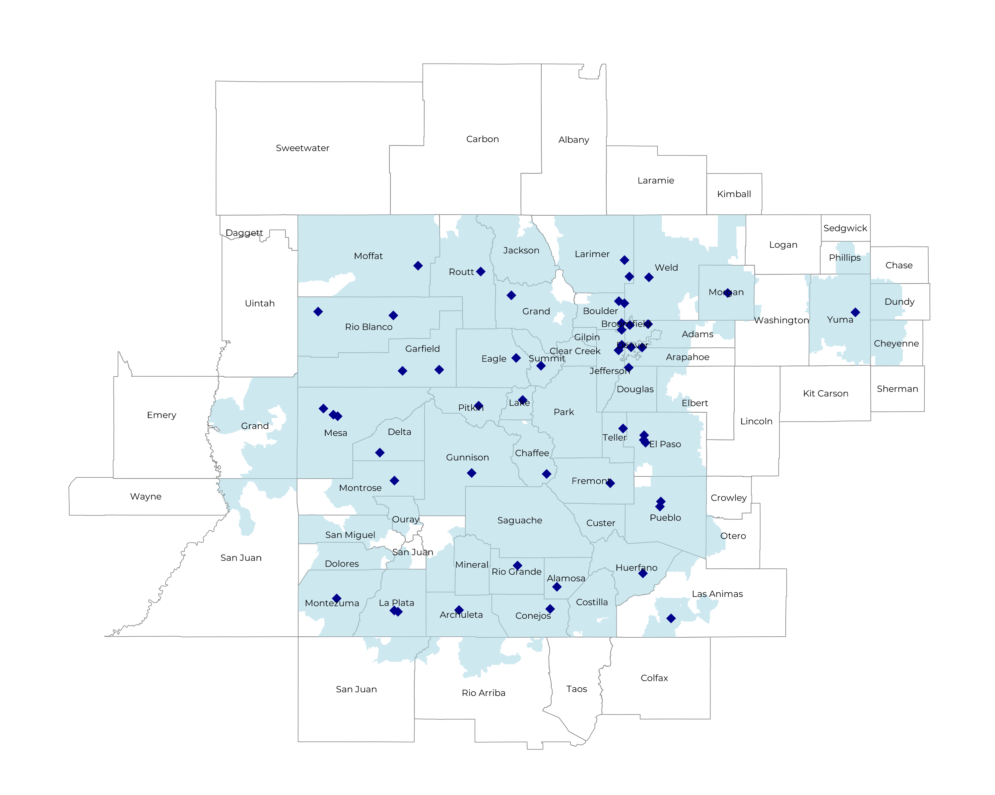
COVERING OVER 95% OF COLORADO’S POPULATION
Self Funded
1,371K
Insured
2,431K
Working Age
3,421K
Population
5,597K

Slide 7
WHA HOSPITALS ARE HIGH-QUALITY
4.1
WHA Hospitals
CMS Stars
Average CMS Quality Star Ratings
Other Colorado Hospitals
3.9
71
67
Mortality
National Percentile for Mortality Prevention
Patient Recommendation Rate
HCAHPS Patient Recommendation
National Percentile
60.2
59.1
74
Readmissions
National Percentile for Readmission Prevention
67

Slide 8
SIGNIFICANT OPPORTUNITY FOR PLAN GROWTH Researched for the below highlighted service area
Target Market 8,000+ Employers 1.4M+ Employees 3.1M+ Members
 | Employer Size Group (# of Employees)
Commercial Employers With Headquarters | 50-100 | 101-200 | 201-400 | 401-1,000 | 1,001-3,000 | 3,000+
In Catchment Area | 4,495 | 1,915 | 1,143 | 605 | 216 | 121
Total Employees at Employers | 50-100 | 101-200 | 201-400 | 401-1,000 | 1,001-3,000 | 3,000+
Headquartered in Catchment Area | 337,100 | 287,300 | 342,900 | 423,500 | 432,000 | 726,000
Total Members with Employers | 50-100 | 101-200 | 201-400 | 401-1,000 | 1,001-3,000 | 3,000+
Headquartered in Catchment Area | 606,800 | 517,100 | 617,200 | 762,300 | 777,600 | 1,306,800

Slide 9
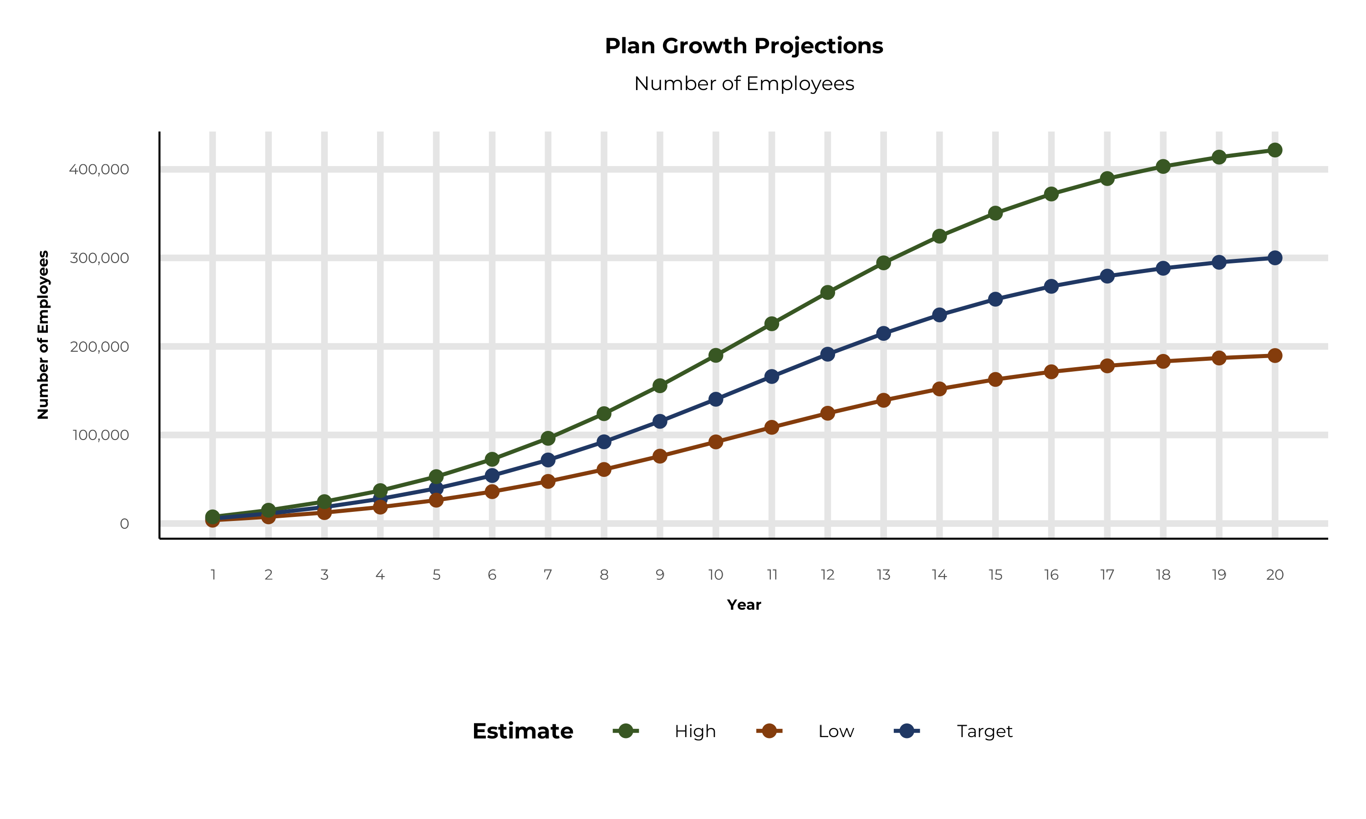
EXPECTED PLAN GROWTH
Year | Employees | Members
1 | 5,600 | 10,100
2 | 11,200 | 20,200
3 | 18,500 | 33,300
4 | 27,800 | 50,000
5 | 39,600 | 71,300
6 | 54,200 | 97,600
7 | 71,800 | 129,200
8 | 92,300 | 166,100
9 | 115,400 | 207,700
10 | 140,400 | 252,700
11 | 166,000 | 298,800
12 | 191,200 | 344,200
13 | 214,700 | 386,500
14 | 235,600 | 424,100
15 | 253,400 | 456,100
16 | 267,900 | 482,200
17 | 279,400 | 502,900
18 | 288,300 | 518,900
19 | 295,000 | 531,000
20 | 300,100 | 540,200
KBA currently estimates that Western Health Alliance has 47% inpatient market share, and 31% outpatient market compared to hospitals/clinics in the Western Health Alliance service area.
A WHA plan could expect patient steerage rates above 85% (comparable to other DTE plans), nearly double of current patient volumes.

Slide 10
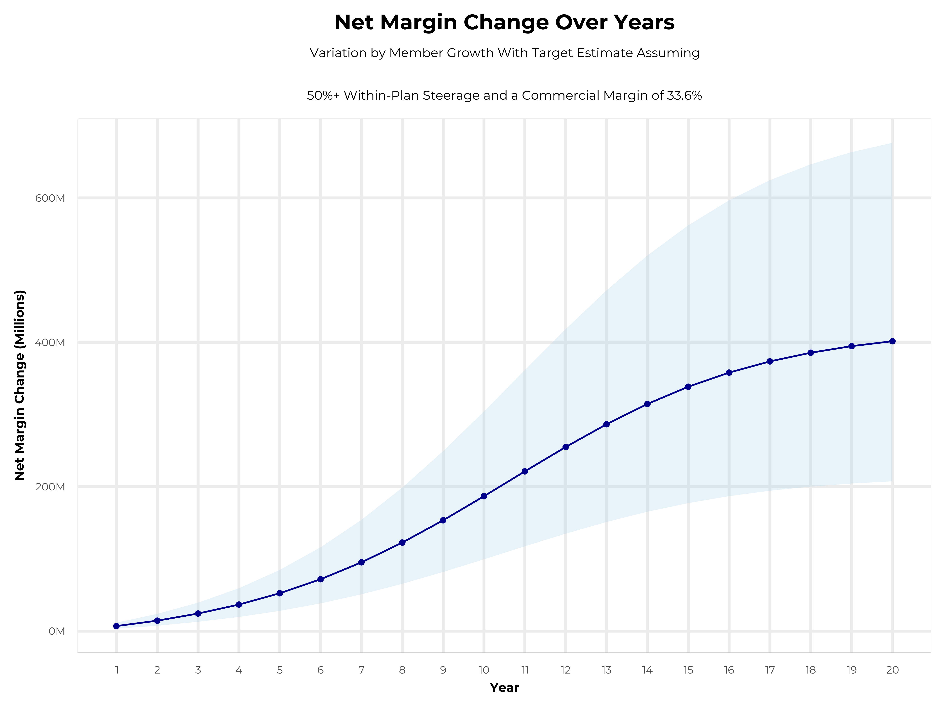
ENORMOUS POTENTIAL PROFITABILITY GROWTH FOR WHA MEMBERS
Early Stage
Gaining Name Recognition, Early Growth
New Revenue:
New Profit:
$125.19M
$34.47M
Growth Stage
Strong Reputation, Strong Growth
New Revenue:
New Profit:
$681.98M
$188.72M
Mature Stage
High Profitability, Market Saturation
New Revenue:
New Profit:
$1324.4M
$366.64M
See Financial Projects Starting on Slide 21 for More Details

Slide 11


INTEGRATION WITH EPIC EHR SYSTEM
KBA shares
evidence-based standards of care for 27 chronic conditions directly into Epic
Hyperthyroidism: Yearly Clinical Evaluation, TSH and T4

Slide 12

THE MISSING PIECE TO VALUE-BASED CARE
Patient engagement is the weak link in delivering value-based care; Western Health Alliance’s clinical leadership and employer participation can drive better outcomes.
KBA’s proactive care-management team supplements your care-management efforts in outreach to clients.
Western Health Alliance excels in Standards of Care completion rates for the Chronically Ill, improving care and costs.
Integrating Western Health Alliance’s managed care with KBA’s programs positions Western Health Alliance as the value leader.

Slide 13

TRANSPARENT PBM INTEGRATION
Support of Western Health Alliance’s retail pharmacy(s)
Optimize Western Health Alliance’s 340B drug
pricing program
Allows Western Health Alliance to create its own PBM program if desired
Custom telephone number with personalized scripting and separate call tracking & reporting
Fully customizable member welcome booklet & materials
White labeled formulary document and marketing materials
CUSTOM CLIENT SUPPORT:
Specialized call center capabilities
Fully customizable plan designs
Operational access to the platform
Customized process and functions to promote DTE strategy
CLINICAL FLEXIBILITY:
Full portfolio of custom formulary offerings – with optimized formulary shield
Clinical programs that drive towards overall DTE strategy
Options for additional drug savings by driving members to lower cost alternatives
Flexibility to customize or layer on utilization management programs

Slide 14
STOP-LOSS INSURANCE THE KBA EXPERIENCE
Tokio Marine
Nationwide
Berkshire Hathaway
Sun Life
Liberty Mutual
Granular (Google)
Companion Life
Crum & Forster
American Fidelity
RGA
Deep relationships with 20+ stop loss underwriters and carriers
Over $150M in annual stop loss premium placement
Comprehensive pricing and medical service analysis performed for each DTE health plan to ensure proper pricing
KBA provides the administration required of the stop-loss markets:
Bordereau Reporting
Claim Reporting and Reconciliation
Evaluation of Networks
Care Management
Initial Underwriting
Negotiation of rates and terms
Plan Design Actuarial

Slide 15

DTE PROGRAM MARKETING & SALES
KBA WORKS WITH YOU TO MANAGE & SELL:
Branding & Messaging
Direct & Brokerage Sales Distribution – Focused Sales Representative
Brochures, Web Site, Media, etc.
Stop-Loss/Level Funded Down to 20 EE Lives
Sell Through Established Brokers in Your Service Area

Slide 16

COMMUNITY BASED SALES STRATEGY
Locally based sales rep with strong community ties
Collaboration with DTE provider partners to identify strategic employers for early adoption and sales
Work with select broker distribution partners with aligned incentives and goals
Pipeline reporting and collaboration with our DTE provider partners
Marketing and promotion of the new option in the community

Slide 17


Complete Marketing System
Customized Branding and Messaging
Customized Brochures
Customized Web Site
Targeted Employer Outreach
Sales System (Social Media, Email, Text, etc.)

Slide 18

THE KBA HEALTHCARE CREDIT CARD
Creating EPO Steerage in a PPO Network
The Healthcare Credit Card is eligible to be used only for specific merchant codes.
To utilize at Specific Healthcare Providers
a. Designated Hospitals
b. Urgent Care Facilities
c. Physicians
d. Eligible Ancillary Providers
Out of Pocket Expenses Qualify
0% Interest Rate
Employee Determines Repayment Schedules
5. To Qualify: Answer One Simple Question
Notes:
Replace with slide 1 of updates provided by Jan, but update design to match the rest of ppt

Slide 19
KEY INCENTIVE PLAN (KIP):
BASE MEDICAL + BONUS BENEFITS = YOUR DEDUCTIBLE CAN SIMPLY VANISH
BENEFIT EXAMPLE |  |  |  |  | CLAIM EXAMPLE
BASE MEDICAL BENEFITS |  | BONUS BENEFITS |  |  | “How Your Deductible Can Vanish”
Deductible |  | Benefits Automatically Included In Your Plan, At NO Additional Cost To You! |  |  | CLAIM EXAMPLE: Heart Attack, with Surgery
Single | $2,500 | Preferred Hospital Stay | 5 Days at $500 / Day |  | OP Radiology/X-Ray | $200
Family | $3,500 | Non-Preferred Hospital Stay | 1 Day at $50 / Day |  | OP Diagnostic Labs | $100
Coinsurance | 80% / 20% | OP Surgery | $700 / 1 Day |  | Preferred Hospital Stay, 5 Days at $500/Day | $2,500
Maximum Out-of-Pocket |  | OP Anesthesia | $250 / 1 Day |  | Critical Illness (Heart Attack Benefit) | $2,000
Single | $3,500 | OP Radiology/X-Ray | $200 / 1 Day |  | Health Screening Benefit (Stress-Test) | $125
Family | $7,000 | OP Diagnostic Labs | $100 / 1 Day |  | Wellness Benefit (Telephonic Coaching) | $125
Chronic Disease Management Regimens of Care, Covered at 100% |  | Health Screening Benefit | $125 / 1 Day |  | TOTAL BONUS BENEFIT PAYABLE | $5,050
Healthcare Specific, Interest Free Credit Card to Cover Out-of-Pocket Costs |  | Wellness Benefit | $125/1 Day |  | Less Your Maximum Out-of-Pocket Cost | ($3,500)
 |  | Critical Illness Benefit* | $2,000 Lump Sum |  | Additional Benefit, Payable Directly to You! | $1,550!
 |  | *Critical Illness Benefits pays for 1st Diagnosis: Heart Attack, Stroke, Internal Cancer
Notes:
Replace with slide 2 of updated ppt provided by Jan, but update to match rest of ppt

Slide 20


THE BENEFIT STEERING THE PATIENT TO WHA
What Will this Claim Cost Me?
Western Health Alliance patients will often receive cash, not bills after care episodes!
Notes:
Make necessary changes to match slide 4 of updated ppt provided by Jan

Slide 21

FINANCIAL PROJECTIONS
& ASSUPTIONS

Slide 22
ESTIMATION OF WHA HOSPITAL’S 2022 PAYER MIX
Payer Group | Total Inpatient Days | Revenue | Payer Mix
All Western Health Alliance | 1,274,098 | $12,883,498K | 100%
Medicare | 289,413 | $1,715,475K | 23%
Medicaid | 265,686 | $1,413,700K | 21%
Other Government Pay | 0
No-Pay, Charity Care | 83,825 | -$884,948K | 7%
Commercial/Self Pay | 635,174 | $9,744,006K | 49%
Estimating Payer Mix
Medicare, Medicaid, and other government payer mixes are estimated as the percentage of inpatient days for each group divided by total inpatient days.
No-pay and charity care is estimated as the percentage of no-pay/charity care compared to total overall revenue.
Commercial/self pay is assumed to be the rest of the total payer mix share.
Estimating Total Inpatient Days
Total inpatient days for ‘No Pay’ and ‘Commercial’ are estimated to be the payer mix estimates for “No Pay, Charity Care” and “Commercial/Self Pay” multiplied by the total number of inpatient days.
Values in blue are taken from the 2021 Medicare Provider Cost Report (https://data.cms.gov/provider-compliance/cost-report/hospital-provider-cost-report/data)
In other analysis, the outpatient payer mix is assumed to mirror the inpatient payer mix.
Values in yellow are taken from Definitive Healthcare data.
Total Medicare patient revenue is reported by CMS in the Medicare Provider Analysis and Review Report (MedPAR)

Slide 23
ESTIMATION OF MARGIN FOR COMMERCIAL VS. GOVERNMENT PAY
The RAND data for Western Health Alliance estimates commercial insurance reimbursements at 315% of Medicare Rates
Estimating Commercial Margin
(Calculated through counterfactual of assuming all CMS/Government pay was paying at commercial rates)
Estimating Gov-Pay Margin
(Calculated through counterfactual of assuming all commercial pay was paying at Medicare rate)
Commercial Revenue | $9,744,006K
Gov-pay revenue at 315% current rate | $9,870,612K
Total Revenue | $19,614,618K
Total Costs | $12,929,440K
Net Income | $6,685,178K
 | 34%
Commercial Revenue Divided by 315% | $3,089,038K
Gov-pay revenue | $3,129,175K
Total Revenue | $6,218,213K
Total Costs | $12,929,440K
Net Income | $ -6,711,227K
 | -108%

Slide 24
ESTIMATING MARKET SHARE
Hospital Name | Number of Beds | Inpatient Total Charges | Outpatient Total Charges | Inpatient Percent of Market Total | Outpatient Percent of Market Total (Assuming 53.7% of Physicians Employed by Hospitals)
Longmont United Hospital | 127 | $ 163,404.2K | $ 373,526.4K | <1% | <1%
Intermountain Health Platte Valley Hospital | 89 | $ 197,567.5K | $ 479,522.4K | <1% | <1%
Montrose Regional Health | 51 | $ 93,284.8K | $ 368,704.3K | <1% | <1%
SLV Health Regional Medical Center | 49 | $ 50,995.2K | $ 209,096.4K | <1% | <1%
Intermountain Health Lutheran Hospital | 242 | $1,286,834.5K | $1,162,092.9K | 3% | 1%
UCHealth Poudre Valley Hospital | 218 | $ 724,691.7K | $1,848,112.4K | 1% | 2%
St Mary-Corwin Medical Center | 42 | $ 129,866.9K | $ 619,673.9K | <1% | 1%
Mercy Hospital | 73 | $ 312,302.3K | $ 741,204.3K | 1% | 1%
St Anthony Hospital | 220 | $1,566,038.2K | $1,188,821.4K | 3% | 1%
UCHealth Parkview Medical Center | 253 | $1,320,818.8K | $1,751,587.6K | 3% | 2%
UCHealth Memorial Hospital Central | 587 | $2,750,138.6K | $3,435,334.9K | 5% | 3%
St Marys Regional Hospital | 252 | $ 935,743.7K | $ 955,248.0K | 2% | 1%
UCHealth University of Colorado Hospital | 709 | $5,880,425.8K | $7,009,125.8K | 12% | 7%
Intermountain Health Saint Joseph Hospital | 352 | $1,666,957.3K | $1,516,265.1K | 3% | 1%
Penrose Hospital | 601 | $2,204,662.1K | $2,318,850.0K | 4% | 2%
St Elizabeth Hospital | 31 | $ 35,482.2K | $ 94,143.4K | <1% | <1%
Community Hospital | 44 | $ 179,674.4K | $ 645,716.1K | <1% | 1%
Delta Health | 49 | $ 42,596.2K | $ 203,765.2K | <1% | <1%
Valley View Hospital | 31 | $ 208,588.4K | $ 560,145.8K | <1% | 1%
Vail Health | 54 | $ 108,275.5K | $ 379,989.3K | <1% | <1%
St Anthony North Health Campus | 118 | $ 550,944.6K | $1,029,253.9K | 1% | 1%
Intermountain Health Good Samaritan Hospital | 183 | $ 844,149.5K | $1,006,871.0K | 2% | 1%
St Anthony Summit Medical Center | 34 | $ 56,468.1K | $ 278,192.1K | <1% | <1%
UCHealth Medical Center of the Rockies | 180 | $1,025,979.3K | $1,010,879.3K | 2% | 1%
OrthoColorado Hospital | 48 | $ 150,959.1K | $ 300,075.1K | <1% | <1%
UCHealth Longs Peak Hospital | 83 | $ 361,807.2K | $ 685,340.5K | 1% | 1%
UCHealth Broomfield Hospital | 20 | $ 65,835.2K | $ 262,711.3K | <1% | <1%
UCHealth Grandview Hospital | 22 | $ 28,302.9K | $ 281,079.2K | <1% | <1%
UCHealth Greeley Hospital | 79 | $ 212,294.2K | $ 492,787.7K | <1% | <1%
UCHealth Highlands Ranch Hospital | 87 | $ 471,434.2K | $ 744,147.9K | 1% | 1%
Rio Grande Hospital | 17 | $ 6,820.0K | $ 48,843.5K | <1% | <1%
Family Health West | 25 | $ 27,429.7K | $ 138,555.0K | <1% | <1%
Conejos County Hospital | 17 | $ 5,293.5K | $ 20,465.8K | <1% | <1%
Wray Community District Hospital | 15 | $ 7,722.8K | $ 52,705.8K | <1% | <1%
Grand River Medical Center | 25 | $ 25,332.3K | $ 172,223.2K | <1% | <1%
Middle Park Health – Kremmling | 24 | $ 8,094.4K | $ 85,417.9K | <1% | <1%
St Vincent General Hospital District | 8 | $ 4,674.0K | $ 22,813.8K | <1% | <1%
Mt San Rafael Hospital | 25 | $ 12,566.7K | $ 86,025.3K | <1% | <1%
Heart of the Rockies Regional Medical Center | 25 | $ 21,020.8K | $ 278,009.8K | <1% | <1%
Aspen Valley Hospital | 25 | $ 33,020.7K | $ 173,036.6K | <1% | <1%
Pioneers Medical Center | 16 | $ 36,355.7K | $ 42,789.6K | <1% | <1%
UCHealth Pikes Peak Regional Hospital | 13 | $ 5,321.9K | $ 91,974.8K | <1% | <1%
47% Inpatient Market Share
31% Outpatient Market Share
For outpatient market share, it is estimated that only 53.7% of local physicians are employed by area hospitals (Research from the Physician Advocacy Institute: https://www.physiciansadvocacyinstitute.org/Portals/0/assets/docs/PAI-Research/PAI-Avalere%20Physician%20Employment%20Trends%20Study%202019-2023%20Final.pdf?ver=uGHF46u1GSeZgYXMKFyYvw%3d%3d)

Slide 25

STEERAGE RATES FOR CURRENT DTE NETWORKS
The average Tier 1 Steerage is 83%.
* Data collected from KBA DTE Networks in Q1 2024

Slide 26
PROJECTED PLAN GROWTH
Year | Employees | Members | Percent of Members Choosing Western Health Alliance for Inpatient Care | Percent of Members Choosing Western Health Alliance for Outpatient Care
1 | 5,600 | 10,100 | 77% | 75%
2 | 11,200 | 20,200 | 77% | 75%
3 | 18,500 | 33,300 | 77% | 76%
4 | 27,800 | 50,000 | 77% | 76%
5 | 39,600 | 71,300 | 77% | 76%
6 | 54,200 | 97,600 | 77% | 76%
7 | 71,800 | 129,200 | 77% | 76%
8 | 92,300 | 166,100 | 77% | 76%
9 | 115,400 | 207,700 | 77% | 76%
10 | 140,400 | 252,700 | 77% | 76%
11 | 166,000 | 298,800 | 77% | 76%
12 | 191,200 | 344,200 | 77% | 76%
13 | 214,700 | 386,500 | 77% | 76%
14 | 235,600 | 424,100 | 77% | 76%
15 | 253,400 | 456,100 | 77% | 76%
16 | 267,900 | 482,200 | 77% | 77%
17 | 279,400 | 502,900 | 77% | 77%
18 | 288,300 | 518,900 | 77% | 77%
19 | 295,000 | 531,000 | 77% | 77%
20 | 300,100 | 540,200 | 77% | 77%
KBA currently estimates that Western Health Alliance has 47% inpatient market share, and 31% outpatient market compared to hospitals/clinics in the Western Health Alliance service area.
Based on previous DTE experience, KBA expects a significant bump in patient steerage to Western Health Alliance.
Additional steerage will occur from additional steerage patient benefits and the patient card.
High estimates start nearly 10% higher than target with low estimates at 10% lower than target

Slide 27
YEAR 4 PROJECTED REVENUE AND PROFIT
Pre-DTE Cohort of 50,100 Employees | Inpatient | Outpatient | Professional | Total
Revenue† | $ 75,860,306 | $ 90,301,099 | $ 42,169,846 | $ 208,331,251
Net Income‡ | $ 20,634,003 | $ 24,561,899 | $ 11,470,198 | $ 56,666,100
† Assuming proportional revenues from market shares of 47% (inpatient) and 31% (outpatient)
‡ Conservatively assuming a commercial margin of 27.2% (80% of the estimated commercial margin)
With DTE | Inpatient | Outpatient | Professional | Total
Revenue⁰ | $ 123,340,511 | $ 221,515,944 | $ 103,446,063 | $ 448,302,518
Net Income* | $ 33,548,619 | $ 60,252,337 | $ 28,137,329 | $ 121,938,285
⁰ Assuming 77% inpatient and 76% market steerage based on KBA narrow network DTE experience (see previous slide)
* Conservatively assuming a commercial margin of 27.2%, with a 10 percentage-point reduction to reflect competitive-edge rates and a 10 percentage-point increase due to lower billing costs and higher patient responsibility collections because of the member credit card.
Total Increase in Net Income | $ 65,272,185
Network Access Fee (Revenue) of $1 PMPM | $ 601,200
Total Profit Growth | $ 65,276,985
Minus Implementation Fee (One-Time) | -$ 0
Minus Sales and Marketing (Annual – Ongoing) | -$ 180,000
Total | $ 65,693,385

Slide 28
Target Estimate Assuming 50%+ Within-Plan Steerage and a Commercial Margin of 33.6% | Target Estimate Assuming 50%+ Within-Plan Steerage and a Commercial Margin of 33.6% | Target Estimate Assuming 50%+ Within-Plan Steerage and a Commercial Margin of 33.6% | Target Estimate Assuming 50%+ Within-Plan Steerage and a Commercial Margin of 33.6% | Target Estimate Assuming 50%+ Within-Plan Steerage and a Commercial Margin of 33.6%
All values in thousands of dollars. Modeled With Year 1 Fees and Patient Steerage. | All values in thousands of dollars. Modeled With Year 1 Fees and Patient Steerage. | All values in thousands of dollars. Modeled With Year 1 Fees and Patient Steerage. | All values in thousands of dollars. Modeled With Year 1 Fees and Patient Steerage. | All values in thousands of dollars. Modeled With Year 1 Fees and Patient Steerage.
Metric | 500 DTE Covered Lives | 1000 DTE Covered Lives | 5000 DTE Covered Lives | 25000 DTE Covered Lives
Pre-DTE Group Inpatient Revenue | $757.1 | $1,514.2 | $7,570.9 | $37,854.4
Pre-DTE Group Inpatient Margin | $205.9 | $411.9 | $2,059.3 | $10,296.4
DTE Group Inpatient Revenue | $1,231.1 | $2,462.2 | $12,311.0 | $61,555.2
DTE Group Inpatient Margin | $334.9 | $669.7 | $3,348.6 | $16,743.0
DTE Group Incremental Inpatient Revenue | $474.0 | $948.0 | $4,740.2 | $23,700.8
DTE Group Incremental Inpatient Margin | $128.9 | $257.9 | $1,289.3 | $6,446.6
Pre-DTE Group Outpatient Revenue | $901.2 | $1,802.4 | $9,012.1 | $45,060.4
Pre-DTE Group Outpatient Margin | $245.1 | $490.3 | $2,451.3 | $12,256.4
DTE Group Outpatient Revenue | $2,180.0 | $4,360.0 | $21,800.2 | $109,000.8
DTE Group Outpatient Margin | $593.0 | $1,185.9 | $5,929.6 | $29,648.2
DTE Group Incremental Outpatient Revenue | $1,278.8 | $2,557.6 | $12,788.1 | $63,940.4
DTE Group Incremental Outpatient Margin | $347.8 | $695.7 | $3,478.4 | $17,391.8
Pre-DTE Group Professional Revenue | $420.9 | $841.7 | $4,208.6 | $21,042.8
Pre-DTE Group Professional Margin | $114.5 | $228.9 | $1,144.7 | $5,723.7
DTE Group Professional Revenue | $1,018.0 | $2,036.1 | $10,180.5 | $50,902.5
DTE Group Professional Margin | $276.9 | $553.8 | $2,769.1 | $13,845.5
DTE Group Incremental Professional Revenue | $597.2 | $1,194.4 | $5,971.9 | $29,859.6
DTE Group Incremental Professional Margin | $162.4 | $324.9 | $1,624.4 | $8,121.8
Net Margin Less DTE Fees | $315.2 | $960.4 | $6,122.0 | $31,930.2

Slide 29
Target Estimate Assuming 50%+ Within-Plan Steerage and a Commercial Margin of 33.6% | Target Estimate Assuming 50%+ Within-Plan Steerage and a Commercial Margin of 33.6% | Target Estimate Assuming 50%+ Within-Plan Steerage and a Commercial Margin of 33.6% | Target Estimate Assuming 50%+ Within-Plan Steerage and a Commercial Margin of 33.6% | Target Estimate Assuming 50%+ Within-Plan Steerage and a Commercial Margin of 33.6%
All values in thousands of dollars. Modeled With Year 1 Fees and Patient Steerage. | All values in thousands of dollars. Modeled With Year 1 Fees and Patient Steerage. | All values in thousands of dollars. Modeled With Year 1 Fees and Patient Steerage. | All values in thousands of dollars. Modeled With Year 1 Fees and Patient Steerage. | All values in thousands of dollars. Modeled With Year 1 Fees and Patient Steerage.
Metric | 500 DTE Covered Lives | 1000 DTE Covered Lives | 5000 DTE Covered Lives | 25000 DTE Covered Lives
Pre-DTE Group Total Revenue | $2,079.2 | $4,158.3 | $20,791.5 | $103,957.7
Pre-DTE Group Total Margin | $565.5 | $1,131.1 | $5,655.3 | $28,276.5
DTE Group Total Revenue | $4,429.2 | $8,858.3 | $44,291.7 | $221,458.5
DTE Group Incremental Total Revenue | $2,350.0 | $4,700.0 | $23,500.2 | $117,500.8
Incremental Total Revenue by Member | $4.7 | $4.7 | $4.7 | $4.7
DTE Group Total Margin | $1,204.7 | $2,409.5 | $12,047.3 | $60,236.7
DTE Group Incremental Total Margin | $639.2 | $1,278.4 | $6,392.0 | $31,960.2
Wellness Share | $6.0 | $12.0 | $60.0 | $300.0
Implementation Fee (One-Time) | $150.0 | $150.0 | $150.0 | $150.0
Sales and Marketing Annual Fee | $180.0 | $180.0 | $180.0 | $180.0
Net Margin Less DTE Fees | $315.2 | $960.4 | $6,122.0 | $31,930.2

Slide 30





A PARTNER YOU CAN TRUST
OUR OBJECTIVES ARE ALIGNED
WE KNOW THE
MARKET
COMPLETELY TRANSPARENT
WE HAVE THE SOPHISTICATION AND INFRASTRUCTURE TO EFFECTIVELY COMPETE
Derek Moore, Senior Vice President – KBA
845-283-9973 * derek.moore@keybenefit.com

